Slide 1
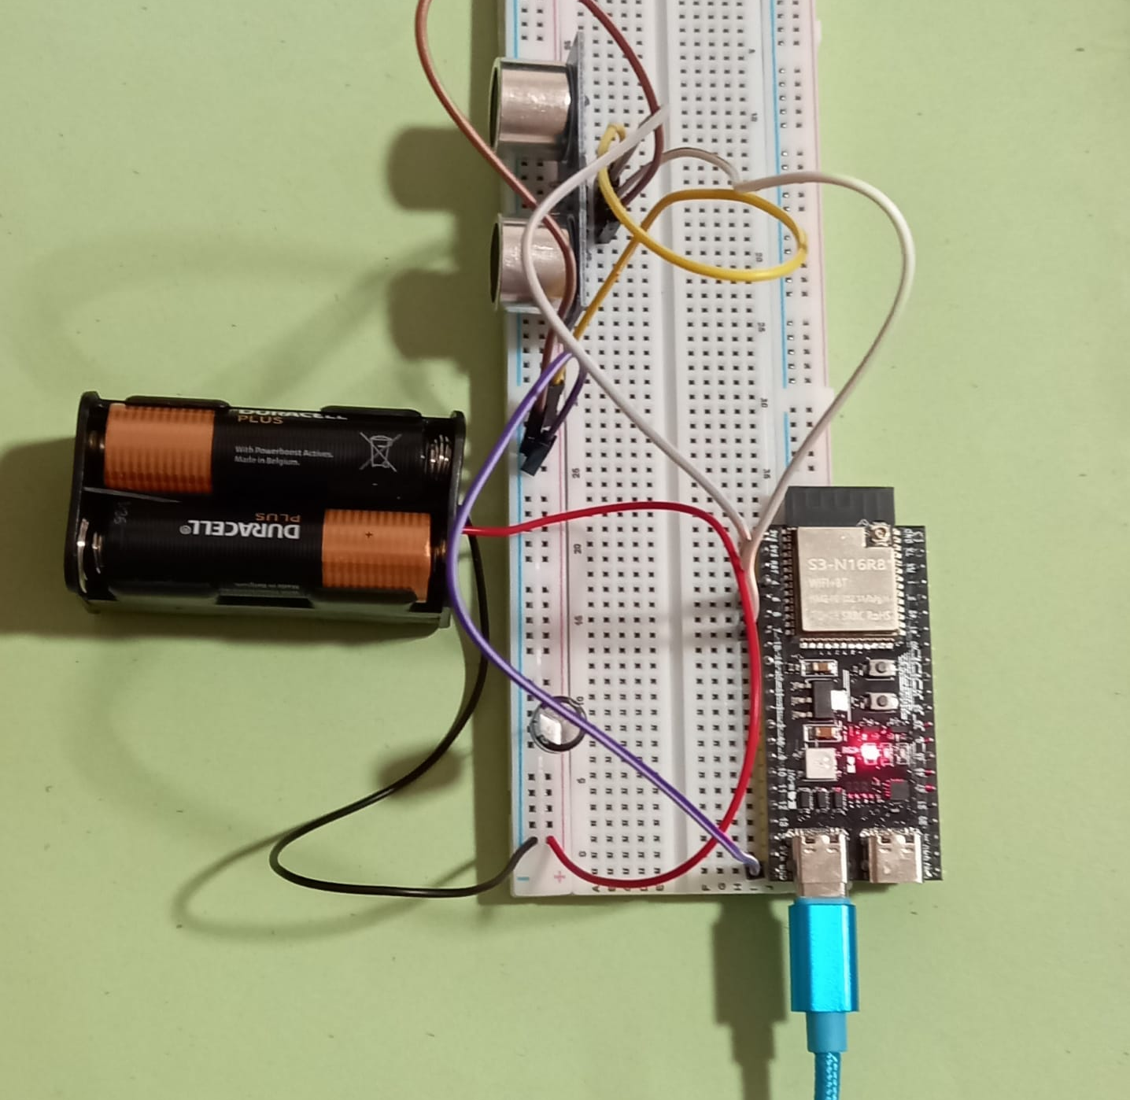

USing sensors
Introduction To Robotics
Sachin Kamat
Hindu Swayamsevak Sangh, Shakti Parivaar Shakha

Slide 2
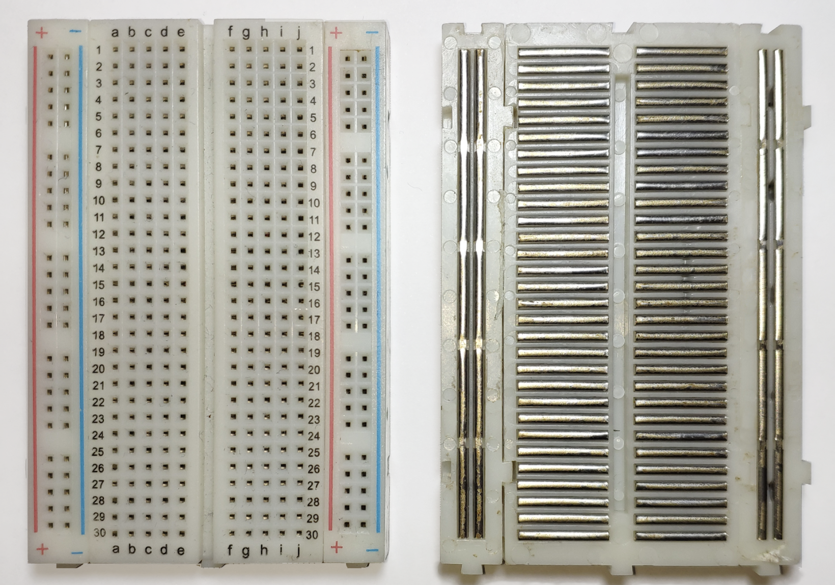
Breadboard

Slide 3
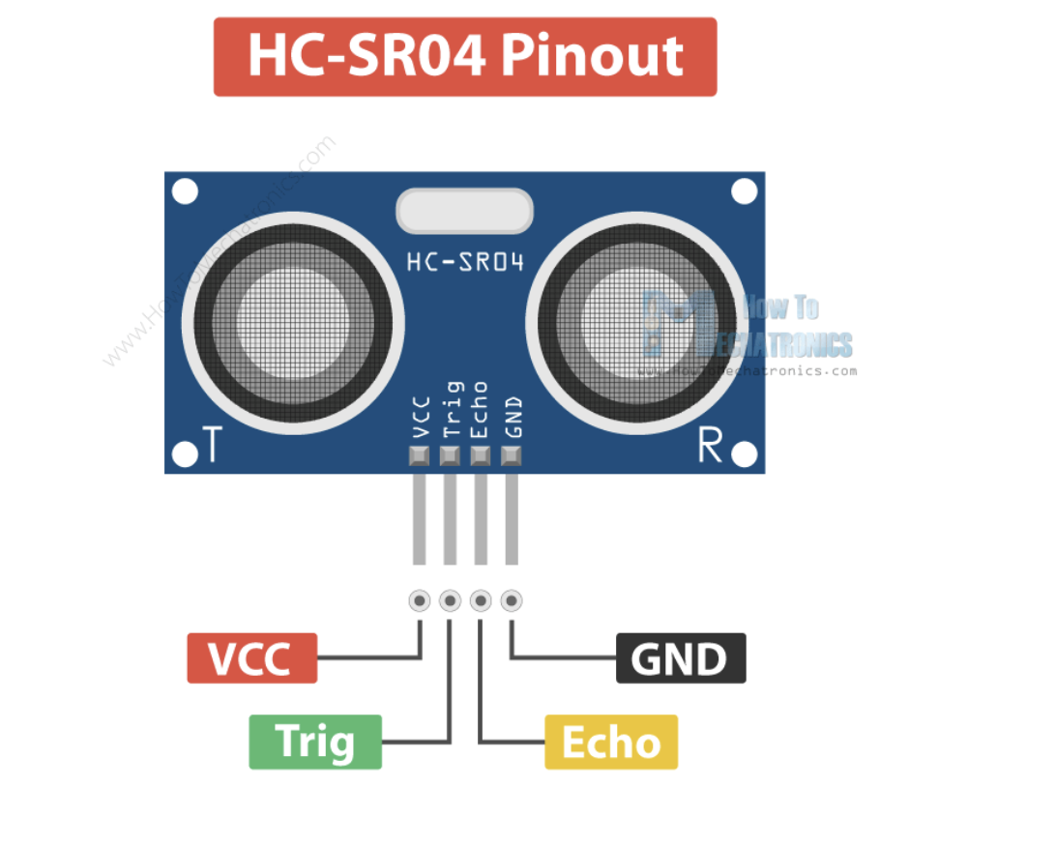
HCSR04

Slide 4
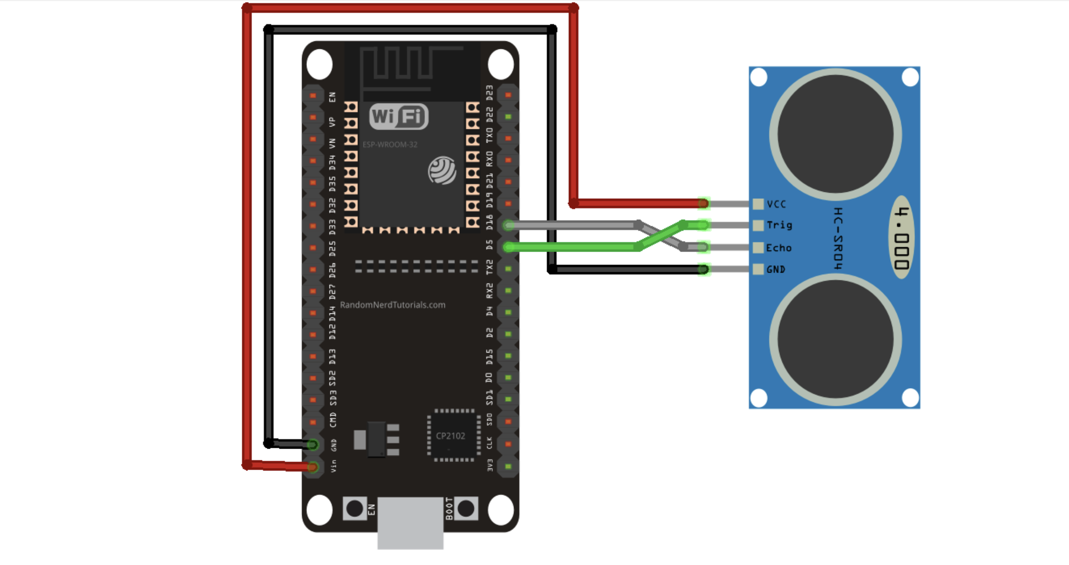
Connections

Slide 5
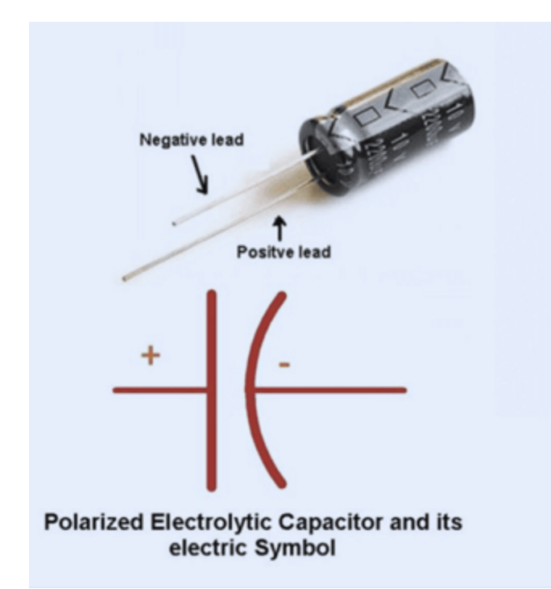
Electrolytic capacitor
Do not reverse to capacitor (postitive to negative). It’s dangerous !

Slide 6
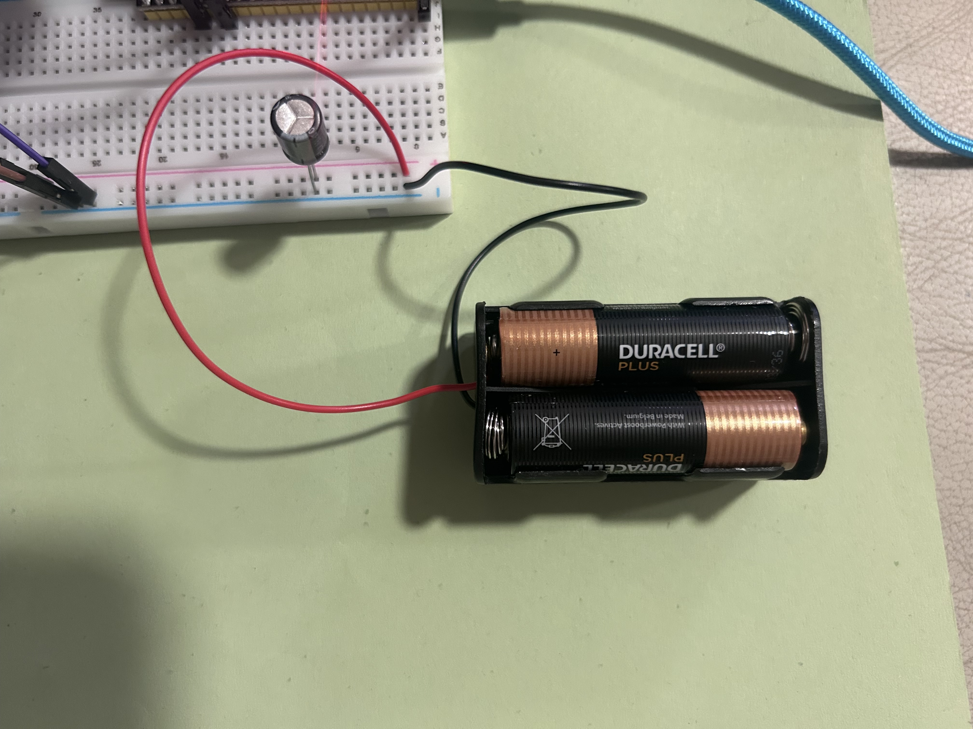
Connecting Batteries

Slide 7
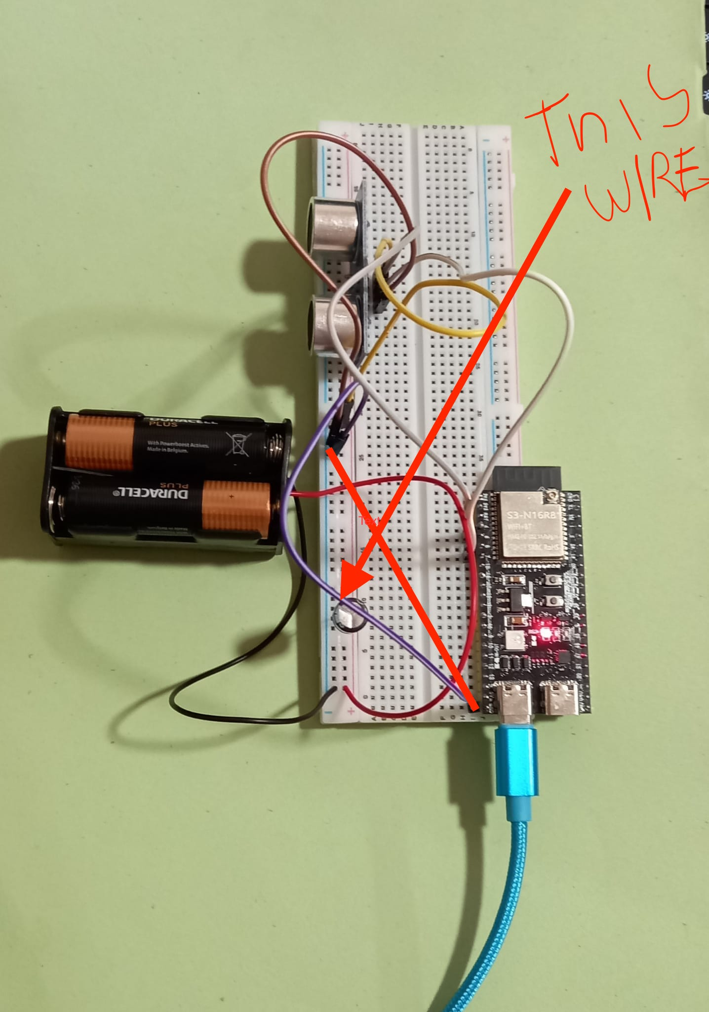
Same GND for ESP32 and sensors
Very Important ! If the ground for sensors and esp32 isn’t same then sensors may not work !

Slide 8
Making sense of the sensor
Copy this module to your esp32 https://github.com/sachin-kamat/Introduction-To-Robotics/blob/main/programs/hcsr04.py
The module contains utility to get data from hcsr04 easily.
Complex calculations related to speed of sound and time are abstracted to simple functions distance_cm() and distance_mm()

Slide 9
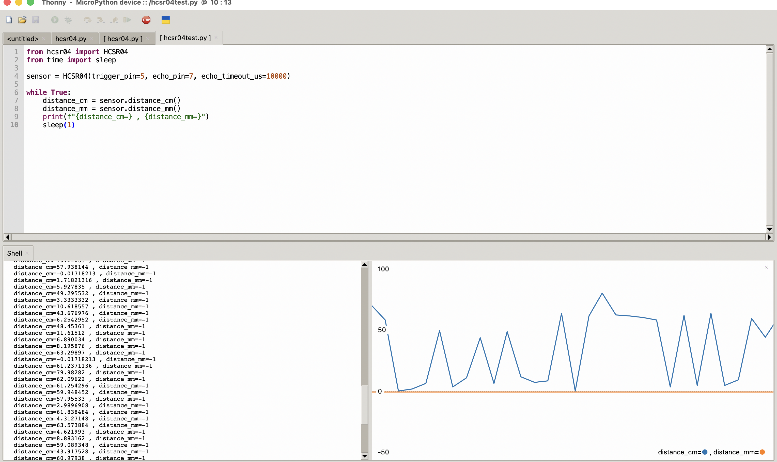
Check if the sensor is workinG

Slide 10
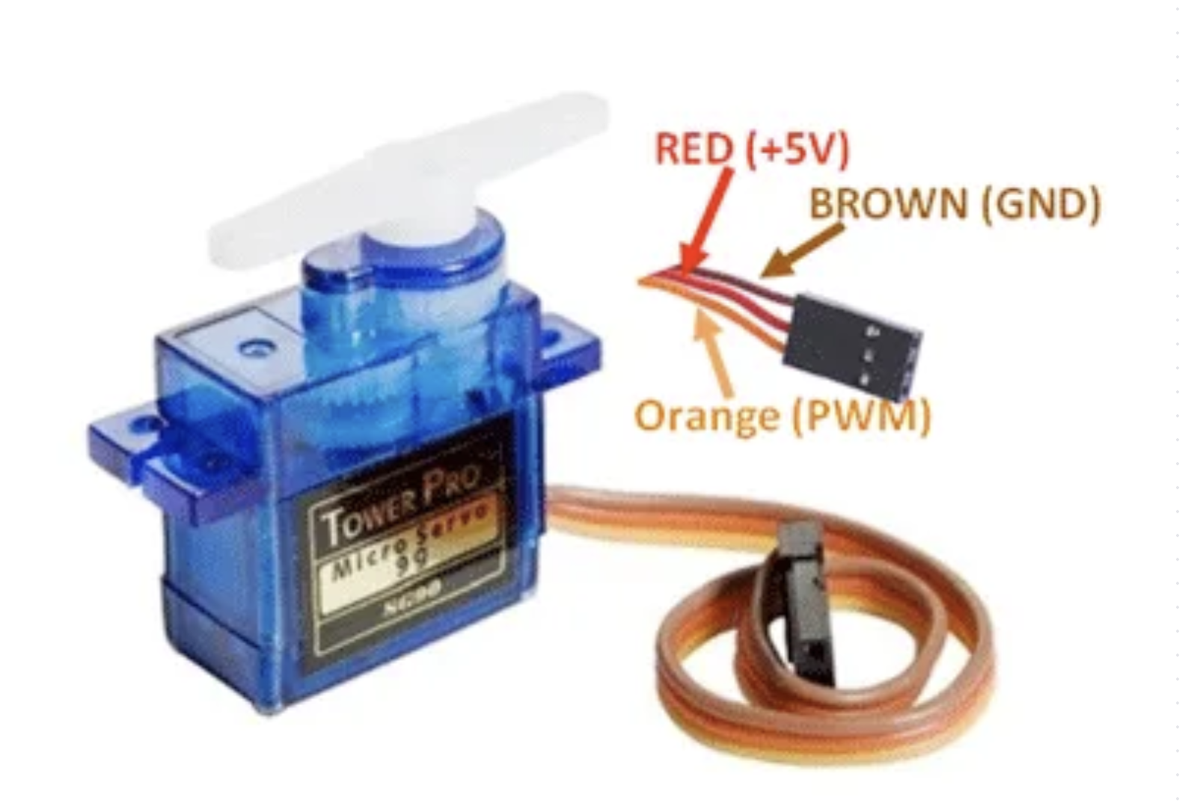
Servo SG90

Slide 11
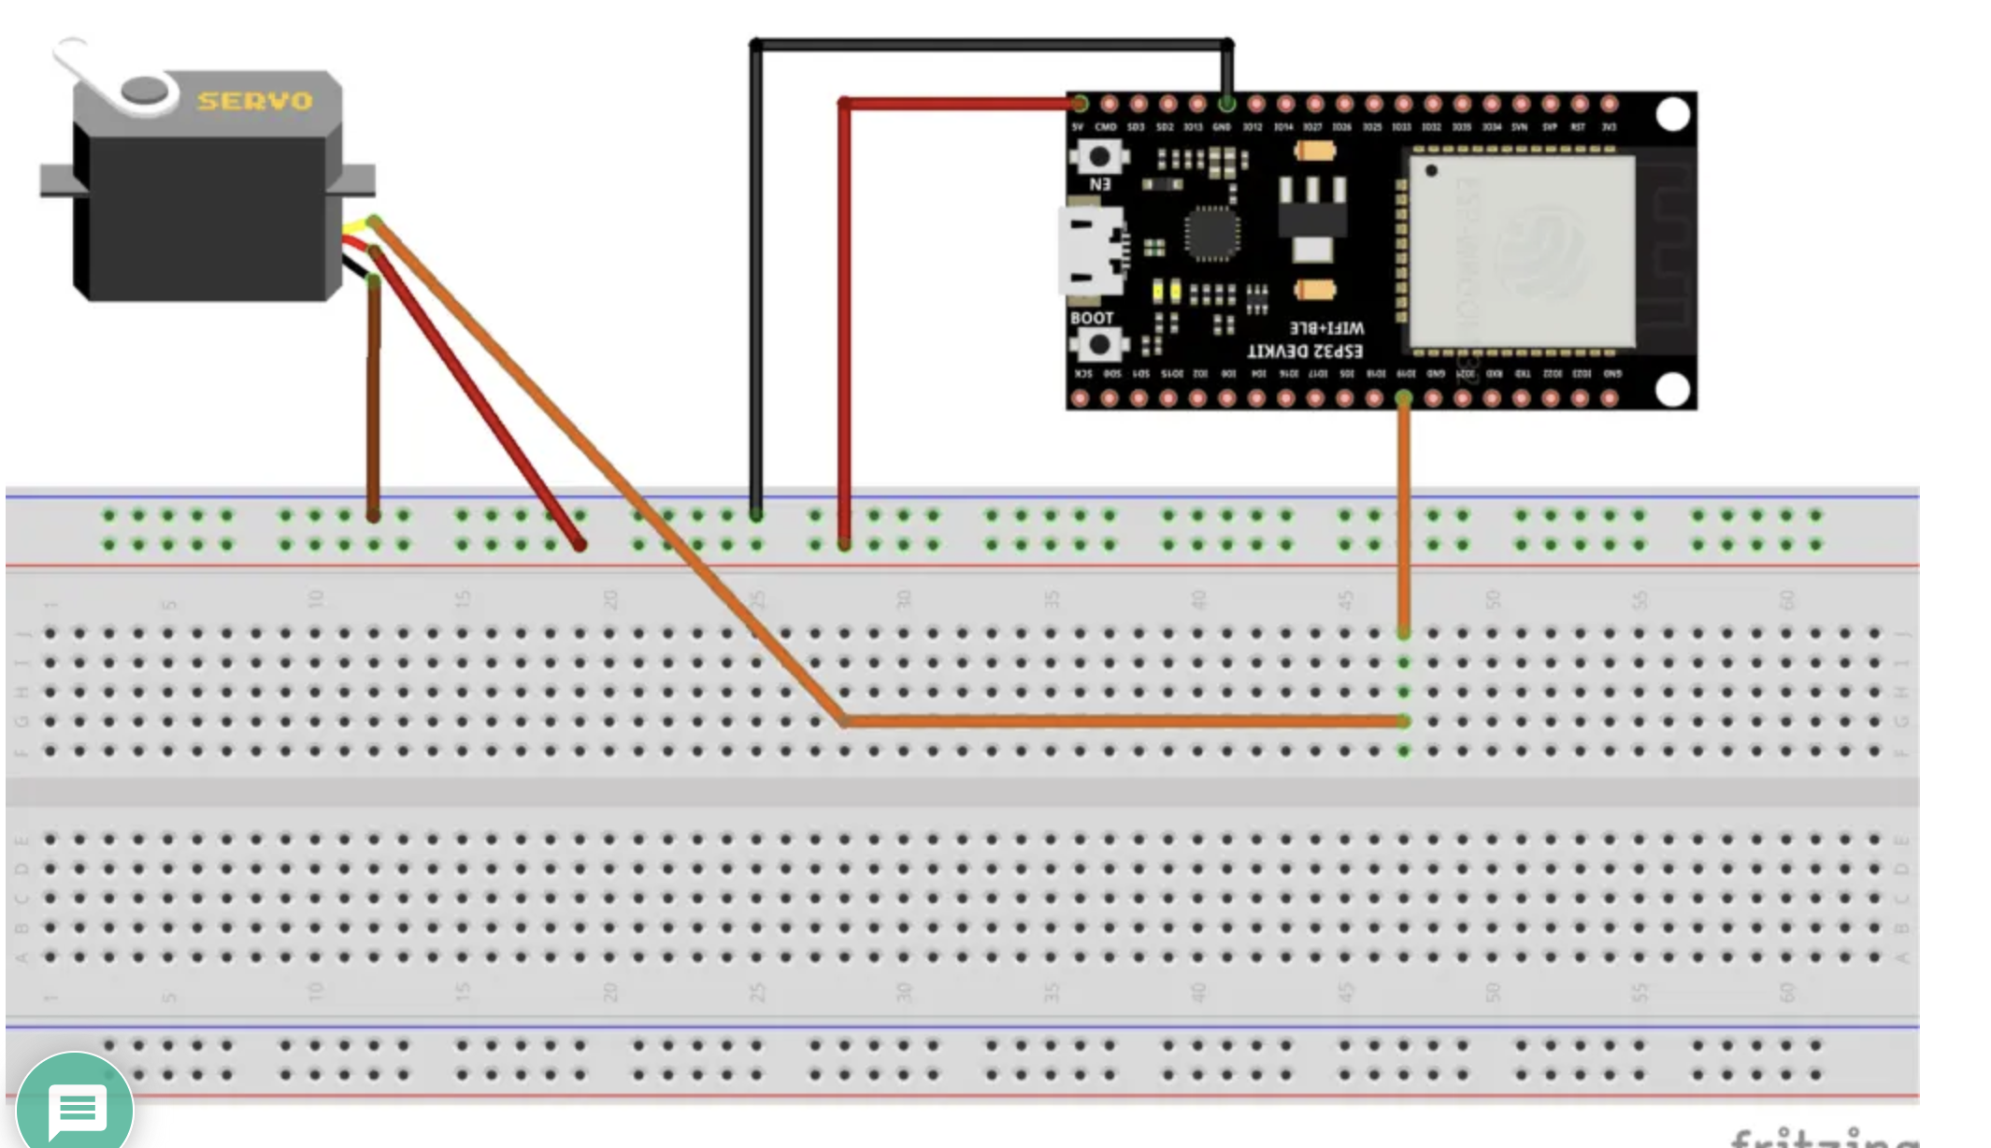
SG90 connections

Slide 12
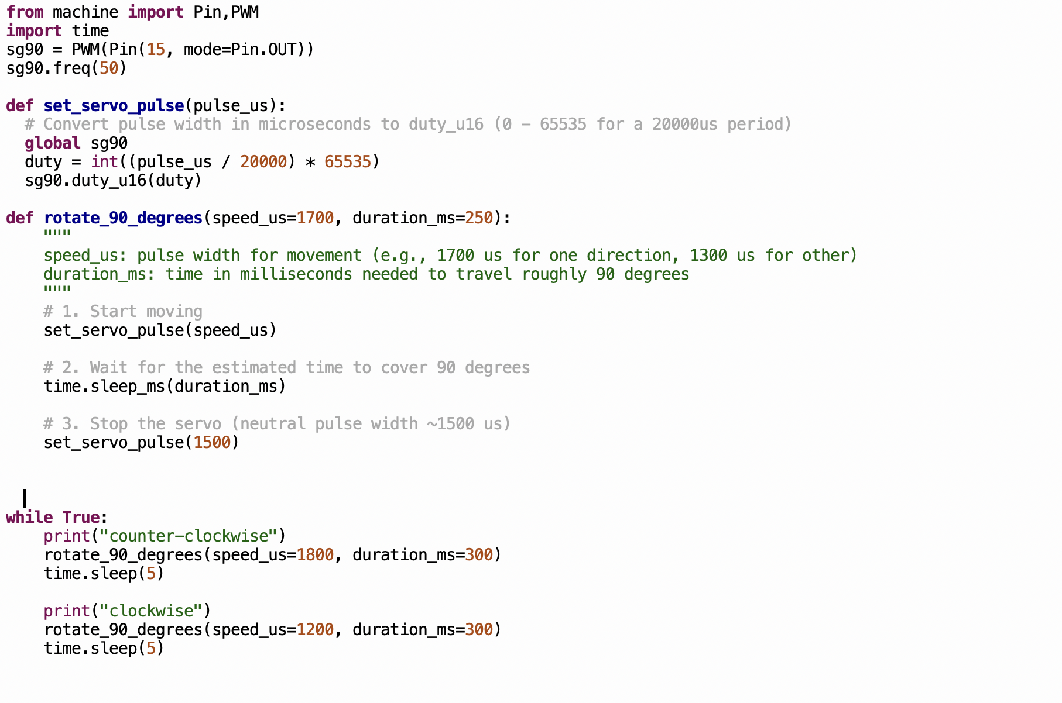
Programming SG90

